Slide 1
WELCOME

Slide 2

A Case Study On Cyber Law
PRESENTED BY :Bijay Khatri and Ujwal Thapa

Slide 3
Contents
OBJECTIVES
CYBER SPACE
CYBER CRIME AND ITS TYPES
CYBER ETHICS
CYBER LAW AND ITS TYPES
CYBER LAW IN NEPAL
CURRENT SITUTION OF CYBER LAW IN NEPAL
IMPLEMENTAION ASPECT OF LAW IN NEPAL
PROS AND CONS OF CYBER LAW
LIMITATION OF LAW IN NEPAL
RECOMMEDATION AND SUGGESTION
REFERENCES

Slide 4
Objectives
To know about the cyber space, cyber law and its history and why we need
How the cyber law comes into practice in Nepal
Present scenario and implementation
Pros and cons of cyber law

Slide 5
Cyber Space
‘Cyber Space’ was used in 1984 by the author, William Gibson in his scientific novel ‘Neuromancer’ to describe virtual world of computer such as the internet, computers, computer network, telecommunication, etc.
Today, Cyber Space has become synonymous with the Internet, however, cyberspace is known as the WWW (World Wide Web).
The Cyber Space is governed by a system of law and regulation called Cyber Law.
Cyber Space is widespread, interconnected digital technology. Often call internet or web(www) invented by Tim Berners-Lee.
Individuals can interact, exchange ideas, share information, provide social support, conduct business, direct actions, create artistic media, play games, engage in political discussion, and so on, using this global network.

Slide 6
Cyber Crime and Cyber Attacks
Cyber crime is any illegal act committed by using a computer.
Unlawful acts wherein the computer is either a tools or a target or both.
Cyber Attack is any attempt to expose, alter, disable, destroy, steal or gain unauthorized access to or make unauthorized use of others resources.
Cyber Crimes like Hacking , Piracy/intellectual Property crimes, identity thief and credit card fraud, malware( Virus, Adware, Spyware, Trojans, Worms, Ransomware , Bot , etc.) attacks and many more.
Cyber Attacks like Malware/Ransomware attacks, Man-In-The Middle attack, DOS/DDOS attacks, SQL injection are the examples.
Zero-Day exploits, phishing, social engineering attacks, online scams/fraud, salami attacks(salami slicing ), cyber defamation, email bombing, pornography and many others.
Note: The first cyber crime was reported in 1820. It was made against the workers who tried to destroy the physical infrastructures complaining their lost of job due to automated machine adapted by the French Cloth Industry.

Slide 7
CLASSIFICATIONS OF CYBER CRIME
Cyber Crime
Based on Computer's Role
Based on the type of victim
Based on Computer’s Role
Computer As A Target
(e.g.. Unauthorized access to computer, malware attack Software/Hardware)
Computer Accidentally Used
(e.g. Child pornography, fraud)
Computer as a helper
(Software Piracy, copyrights infringement)
Computer As Tool
(e.g. credit card fraud, telecom fraud, spam)

Slide 8
Based on type of victim
Affecting Financial Health
Affecting the nation’s security
Affecting Individuals
Affecting Individual
Violation of Privacy
Identity Theft
Cyber Stalking
Spoofing
Counterfeiting

Slide 9
Forgery ad counterfeiting
Password Cracking
Hacking
Theft of Telecom Service
Piracy and Copyright Infringement
Computer Sabotage and Extortion
DOS Attack
Economic Espionage
Money Laundering
Cyber squatting
Trade Libel
Malware(Hard/Soft)
Computer or Online Fraud
Scam, Phishing Attack, Online Auction Fraud,etc

Slide 10
Cyber Ethics
Cyber ethics is the philosophic study of ethics related to computers, encompassing user behaviour and what computers are programmed to do, and how this affects individuals and society.

Slide 11
Cyber Law
Cyber law is the law that includes a variety of issues related to the internet and other communication technology, including intellectual property, privacy, freedom of expression, and jurisdiction.
The Cyber law governs the legal issues of cyberspace.
Cyber Law is also knows as Internet Law.
Prevent or reduce large scale damage from cybercriminal activities by protecting information access, privacy, communications, intellectual property (IP) and freedom of speech related to the use of the Internet, websites, email, computers, cell phones, software and hardware, such as data storage devices.
The regulation of information technology, through computing and the internet evolved out of the development of the first publicly funded networks, such as ARPANET and NSFNET in the United States or JANET in the United Kingdom.

Slide 12


Intellectual property (IP) refers to creations of the mind, such as inventions; literary and artistic works; designs; and symbols, names and images used in commerce.
Copyright Law is the main form of Intellectual Property cyber law. It provides protection to almost any piece of IP you can transmit over the internet. This can include books, music, movies, blogs, and much more related to wide range of creative, intellectual, or artistic forms, or works.

Slide 13


Patents Law are use to protect an invention. It helps to protect the new software/ideas and the new business methods.
Trademarks/Service Marks Law are used to recognized the domain name, recognizable design/sign to distinguish services/products. A trademark is a recognizable sign, design or expression which distinguishes products or services of a particular trader from the similar products or services of other traders.

Slide 14
Trade Secret is any information about a business that could give a competitive advantage to another person or business and is not generally known or easily obtainable by others which can include confidential manufacturing, industrial, or commercial information.
Privacy law refers to the laws that deal with the regulating, storing, and using of personally identifiable information of individuals, which can be collected by governments, public or private organizations, or other individuals.
Violation of any intellectual property law cause the infringement of the law.
For Example: Copyright infringement is when a person breaks the rules of copyright by using another person's work without their permission and it is a crime whether it is done knowingly or unknowingly or by mistake We can see this in practically like YouTube copyright infringement cause you tuber to pay money or( block their account or legal case ) to content creator or copyright holder of the content
People often use the term Fair Use or Disclaimer to safeguard themselves from being illegal or infringement of law.

Slide 15
Technology uses :
Encryption and digital signature system to ensure that only the authorized person can have full control over the information.
Integrity and authenticity of information is maintained by using the pair key system(public-private key).
Digital signature allows records for Electronic Data Interface (EDI) in various e-sectors for the data transformation, such as email, e-business, e-banking, etc.
Different Hashing algorithm and encryption mechanism are use to generated the digital signature.

Slide 16
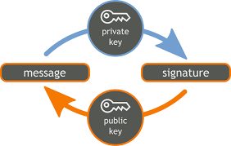

Digital Signature System

Slide 17
International Cyber Law
Freedom of Information Act in 1970 – The right provided by the state to the public to see the information.
Video Privacy Protection Act in 1988 – No one can see and use the other’s personal record without the court’s order.
Copyright Act 1992 – The law to stop unauthorized copy. The penalty is 5 years in custody and a fine of US dollar 250,000.
General Data Protection Regulation – This law state "right to be forgotten", which requires any group that collects data on individuals to delete the data related to an individual upon that individual's request.(updated on 25 may 2018)

Slide 18
Cyber Law in Nepal
Background:
Prior to 2004, the government of Nepal dealt with cyber crime under the Public Offence Act. Nepal Police dealt with Cyber crimes but they were not aware about the technical aspects of these crimes, which meant that the sanctions were not effective and relative to the crime.
Later the Electronic Transaction and Digital Signature Act 2004, also known as the cyber law, was passed.
Under this law, the government can punish cyber offenders with up to 5 years of imprisonment and/or a fine up to the severity of the crime.

Slide 19
Electronic Transactions act,2063
The Electronic Transactions act,2063 is the Nepal’s First Cyber Law came in Practice from Bhadra 24 2063B.S(2 September 2006 A.D).
It consists of 12 Chapter(80 Articles).
The law has tightened the security for banking transactions through electronic means, which should boost the economic activities across the internet via Nepal.
Major Provision of This Act are:
Provisions Relating to Electronic Record and Digital Signature from Chapter 2(Article 2-9) describe the use of Asymmetric Crypto Key and Hash Function for authenticity of digital signature and how electronic record can be use as the legal record.
Provision Relating to Dispatch, Receipt and Acknowledgement of Electronic Records(chapter 3;Article 10-12) ensure the validation of records.

Slide 20
Provisions relating to Controller and Certifying Authority(chapter 4; Article 13-29) describes who holds the authority of License to certifying authority, how License is obtain by CA, when to renew/suspended/revoke the License and the responsibility/power of controller.
Provisions relating to Digital Signature and Certificates(chapter 5; Article 30-34) describe the responsibility of certifying authority, how a person can obtain the certificate and when to renew/revoke the certificate.
Functions, Duties and Rights of Subscriber(chapter 6; Article 35-38) describe the responsibility of digital signature holder, how to use the certificate and what happen when private key is compromised.
Electronic Record and Government use of Digital Signature(chapter 7; Article 39-41) describe the use of digital signature in governmental works.
Provisions relating to Network Service(chapter 8; Article 42-43) describes liability of network services provider.
Offence relating To Computer(chapter 9 ; Article 44-59) describe broadly punishment to a hacker who damages programs or data residing in other computer or network or illegally copies them.

Slide 21
We can discuss detail of 17 article related the punishment to different level of crime.
Article -44: Piracy, amendment or destruction of computer source code leads to 3 years jail or Rs.2,00,000 as fine or both.
Article-45: Access to unauthorized items leads to 3 years jail or Rs.2,00,000 as fine or both depend on the seriousness of offence.
Article-46: Damage to computer and information system leads to 3 years jail or Rs.2,00,000 as fine or both.
Article-47: Publishing illegal things in electronic format leads to less than (i) 5 years jail or Rs.100000 as fine or both. (ii) If the act is repeated , punishment is unto 1.5 times of previous punishment.
Article-48: Privacy transgress leads to 2 years jail or Rs.100000 as fine or both depending on the degree of the offence.
Article-49: Publishing false information leads to 2 years jail or Rs.1,00,000 as fine or both.

Slide 22
Article-50: Publishing False License or Certificate leads to (i) 2 years jail or Rs.1,00,000 as fine or both (ii) If incomplete, up to Rs.1,00,000 as fine (iii) If consciously done,2 years jail or Rs.1,00,000 as fine or both.
Article-51: Not admitting assigned description or document leads to fine up to Rs.50,000.
Article-52: Computer fraud leads to 2 years jail or Rs.1,00,000 as fine or both.
Article-53: Encouraging for committing cyber crime leads to 6 month jail or Rs.50,000 as fine.
Article-54: Helper will be assigned half punishment than committer.
Article-55: Cyber Crime committed out of Nepal: Issue will be forwarded as per the law if the system is located in Nepal.
Article-56:Confiscation: Used computers ,computer system, floppy disk, CDs or related equipment's are be confiscated.
Article-57:Guilt from an organized institution: Responsible Person will be taken as guilt.
Article-58:Others lead to 6 month jail or Rs.50,000 as surcharge or both.

Slide 23
Provisions Relating to Information Technology Tribunal(chapter 10; Articles 60-65`)
Provisions Relating to Information Technology Appellate Tribunal(chapter 11; Article 66-71)
Miscellaneous(chapter 12; Article 72-80)
Other Laws and Rules in Nepal
"Copyright Rules, (2061) 2004"
“Telecommunication Policy, 2060 (2004)”
Universal Declaration of Human Rights
“Muluki Aparadh Ain 2074”

Slide 24
Current Situation of Cyber Law in Nepal
Although the law is present, it remain constant whereas at the same time the web and technology is changing.
Trend of cyber crime has changed in Nepal in comparison to previous years. Before, it was limited to data piracy, email blackmail, SMS blackmail, etc. whereas today it has reached a wide variety such as phishing , unauthorized access, online fraud, online illegal activities, etc. and there’s whole another level of social media related crime going on.
Nepal faces a huge hindrance due to its limited policies and regulation.
Lack of investigation and cyber forensic has diminished the chance of catching the criminals. Information Technology is changing all aspects of human activity and in such case Cyber Law is essential to the most. Online communication has risen to a new level and to protect it from being turned to a serious crime, Cyber Law of Nepal has to overcome the challenges it faces.
Note: Over 58 government websites, including those of Department of Passports and Nepal Law Commission, were hacked in the past one year. The frequent cyber-attacks show how vulnerable the country’s cyberspace is. In 2016, Metropolitan Police Crime Division arrested Bikash Poudel of Balaju in Nagarjun Municipality on the charge of hacking over 200 official websites of government and nongovernmental organizations.

Slide 25
Implementation Aspect of Cyber Law
National Investigation Department (NID) is the main intelligence agency of Nepal collecting information about country’s public security, economic crimes, corruption, domestic and cross border terrorism, money laundering, narcotics, and human trafficking. NID works under the Home Ministry of Nepal.
Central Investigation Bureau and MPCD (Metropolitan Police Crime Division) are two key branches of Nepal Police deal with cases of cybercrime as per the Electronic Transaction Act, 2008.
Ministry of Communication and Information Technology had banned the raunchy content last year(2018).
The government will set up two new Bureau in Nepal Police, Cyber Bureau and Human Trafficking Control Bureau along with Central Investigation Bureau and Special Bureau
Age restriction and Time limitation for Battel Game like Pubg Mobile this year(2019).

Slide 26
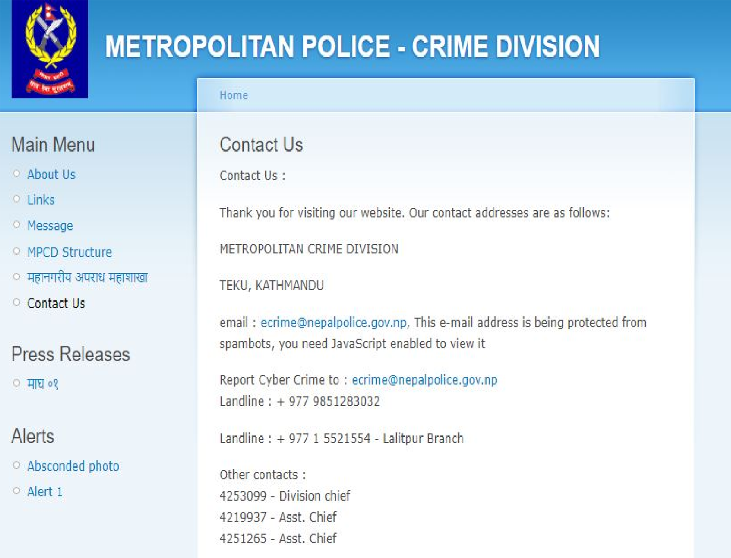
TO REPORT ABOUT THE ANY CYBER CRIME

Slide 27
Advantage of Cyber Law
Protect your business and personal information by ensuring the digital signature and encryption technology.
Awareness about the Law and consequences and cyber attacks which also help to prevent the cyber attacks.
Digital Certificate for securing sites.
Proper monitoring of traffic.
Security against common frauds.
Freedom of expression and the intellectual rights is preserved.

Slide 28
Disadvantage of Cyber Law
Cyber Law is really importance and necessary code of conduct for this present world of cyberspace but due to some technical misunderstanding , leads to cons.
Some are as follows:
Ambiguous Terms: Important terms in the law are not clearly defined. This is dangerous as it may have various degrees of interpretation. For example, online libel does not define, as to whether or not certain situations are consider libels . Ambiguous terms may also be found in the provision for Real time collection of data, etc.
Only the broad aspect of crime are discussed, technical aspect or precise level of crime is not mentioned.
Political influence/fake news while implementing the law.
Maintenance of law and update with the needs, complexity and change of technology.

Slide 29
Limitation of Cyber Law in Nepal
Lack of awareness about the law cause unknowingly performing of cyber crimes.
Lack of common practice leads to the massive attacks and hacking.
Although there is law, it does not cover all the aspect of cyber space and level of expertise.
Implementation of law very weak.
Use of Tor, VPN, Proxy and other online encryption technology make attacks difficult to trace.

Slide 30
Recommendation and Suggestion
Cyber Law cannot protect from attack. So , we have to implement the security measure to protect our information.
Always use full-service internet security suite , which support https and real time protection.
Don't use pirated software and cracked applications.
Use strong and unique password for different sites/services.
Keep your software updated.
Manage your social media settings.
Secure your wireless network at home or office.
Keep an eye and talk to your children about the internet.
Keep up to date on major security breaches and updates with patches.
Take measure to help protect yourself against identity thieves.
Know what to do if you become victim.

Slide 31
Educate Yourself about the existing law regarding the cyber space and help other people know the rules and practise them .
Governmental bodies should increase their capacity, expertise, technological skills and use the latest technology to protect the people from cyber attack.
Awareness about the existing law, common thread should be effectively done by Cyber Crime department of Nepal.
Besides, everyone should be responsible for their action so think twice before act.

Slide 32
Reference:
https://www.nepalpolice.gov.np/images/general_notice/muluki_aparadh_ain_2074.pdf
http://www.crimediv.gov.np/?q=node/7
https://doit.gov.np/en/resources/2
http://www.lawcommission.gov.np/en/archives/16951
https://cib.nepalpolice.gov.np/
https://en.wikipedia.org/wiki/National_Investigation_Department_of_Nepal
https://en.wikipedia.org/wiki/Nepal#Crime_and_law_enforcement
http://www.crimediv.gov.np/
https://en.wikipedia.org/wiki/Intellectual_property#Intellectual_property_rights
https://en.wikipedia.org/wiki/Copyright
https://en.wikipedia.org/wiki/Trademark
https://en.wikipedia.org/wiki/Intellectual_property#Intellectual_property_rights

Slide 33
THANK YOU

